Slide 1
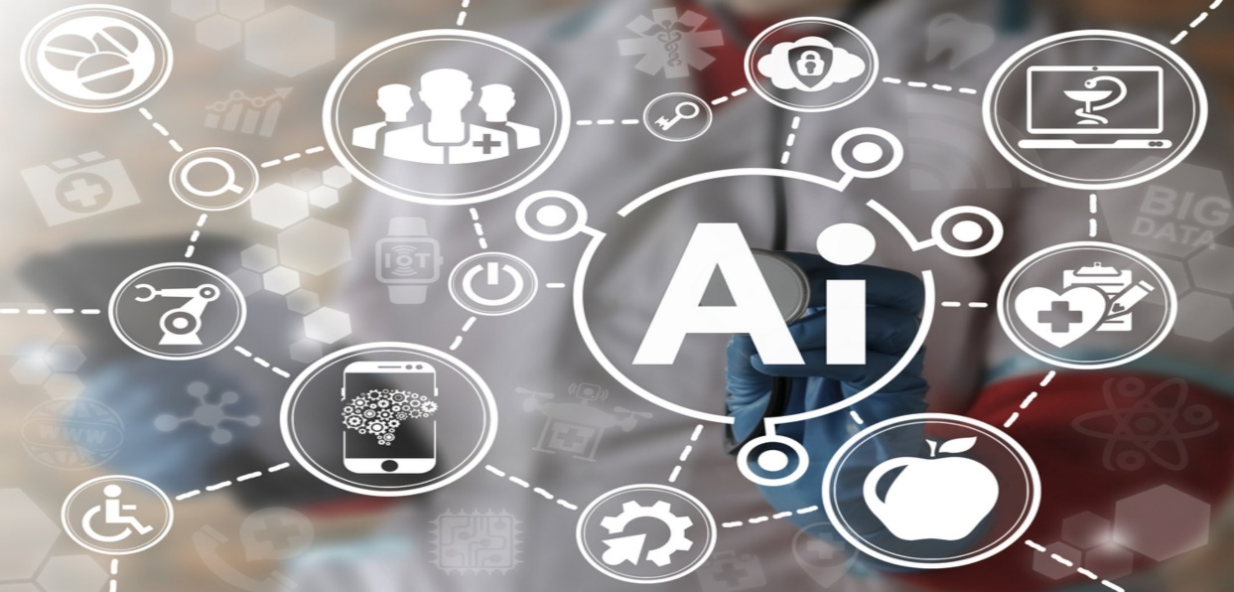
ARTIFICIAL INTELLIGENCE
Artificial intelligence (AI, also machine intelligence, MI) is intelligence displayed by machines, in contrast with the natural intelligence (NI) displayed by humans and other animals. In computer science, AI research is defined as the study of "intelligent agents": any device that perceives its environment and takes actions that maximize its chance of success at some goal. Colloquially, the term "artificial intelligence" is applied when a machine mimics "cognitive" functions that humans associate with other human minds, such as "learning" and "problem solving".

Slide 2
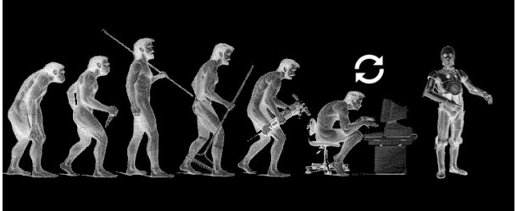
HISTORY:
While thought-capable artificial beings appeared as storytelling devices in antiquity, the idea of actually trying to build a machine to perform useful reasoning may have begun with Ramon Llull (c. 1300 CE). With his Calculus ratiocinator, Gottfried Leibniz extended the concept of the calculating machine (Wilhelm Schickard engineered the first one around 1623), intending to perform operations on concepts rather than numbers. Since the 19th century, artificial beings are common in fiction, as in Mary Shelley's Frankenstein or Karel Čapek’s R.U.R. (Rossum's Universal Robots).

Slide 3
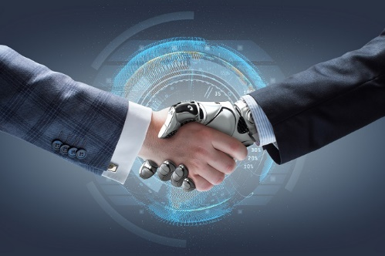
GOALS:
The overall research goal of artificial intelligence is to create technology that allows computers and machines to function in an intelligent manner. The general problem of simulating (or creating) intelligence has been broken down into sub-problems. These consist of particular traits or capabilities that researchers expect an intelligent system to display. The traits mentioned here have received the most attention: Reasoning, problem solving, knowledge representation, planning, learning, natural language processing, perception, motion and manuplation, social intelligence, creativity and General intelligence.

Slide 4
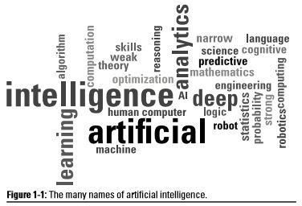
APPROACHES:
There is no established unifying theory or paradigm that guides AI research. Researchers disagree about many issues. A few of the most long standing questions that have remained unanswered are these: should artificial intelligence simulate natural intelligence by studying psychology or neurology? Or is human biology as irrelevant to AI research as bird biology is to aeronautical engineering? Can intelligent behavior be described using simple, elegant principles (such as logic or optimization)? Or does it necessarily require solving a large number of completely unrelated problems? Can intelligence be reproduced using high-level symbols, similar to words and ideas? Or does it require "sub-symbolic" processing? John Haugeland, who coined the term GOFAI (Good Old-Fashioned Artificial Intelligence), also proposed that AI should more properly be referred to as synthetic intelligence, a term which has since been adopted by some non-GOFAI researchers.

Slide 5
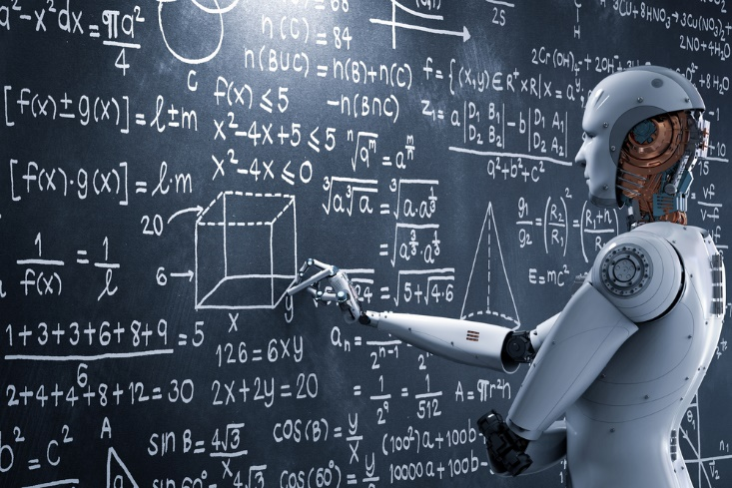
TOOLS:
In the course of 60 or so years of research, AI has developed a large number of tools to solve the most difficult problems in Computer Science. A few of the most general of these methods are: Search and ptimization, Logic, Probabilistic methods for uncertain reasoning, Classifiers and statistical learning methods, Neural networks, Deep feedforward neural networks, Deep recurrent neural networks, etc.

Slide 6
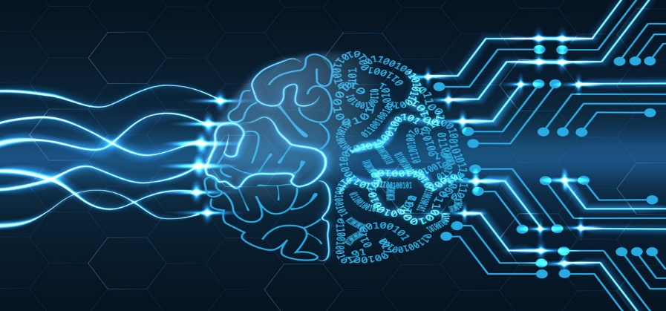
LANGUAGES IN USE:
AI researchers have developed several specialized languages for AI research, including Lisp, Prolog, Python and C++.

Slide 7
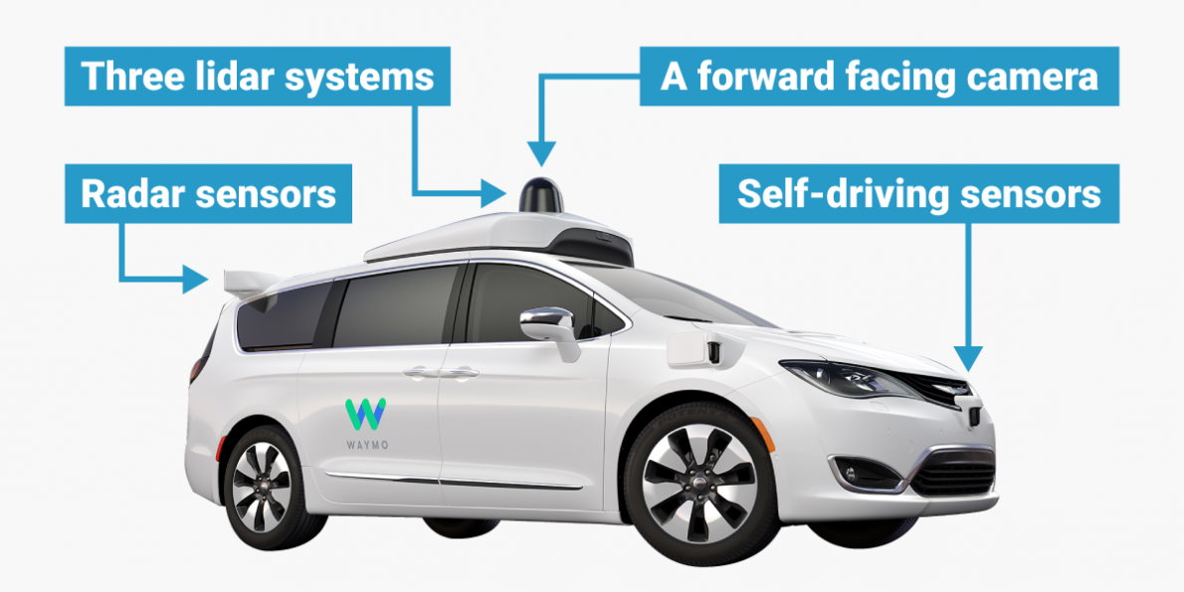
APPLICATIONS:
AI is relevant to any intellectual task. Modern artificial intelligence techniques are pervasive and are too numerous to list here. Frequently, when a technique reaches mainstream use, it is no longer considered artificial intelligence; this phenomenon is described as the AI effect.
High-profile examples of AI include autonomous vehicles (such as drones and self-driving cars), medical diagnosis, creating art (such as poetry), proving mathematical theorems, playing games (such as Chess or Go), search engines (such as Google search), online assistants (such as Siri), image recognition in photographs, spam filtering, prediction of judicial decisions and targeting online advertisements.

Slide 8
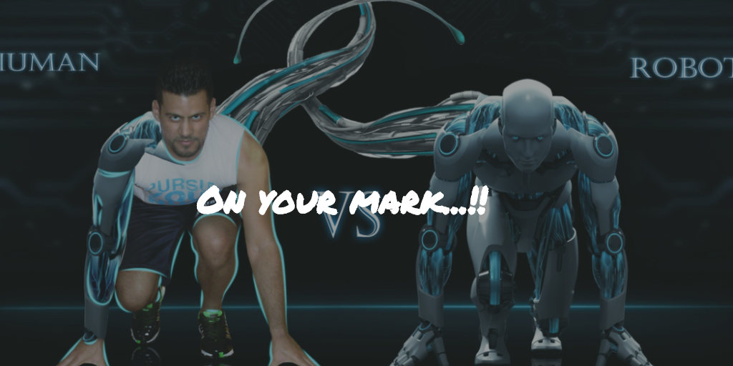
CONCLUSION:
Artificial Intelligence and the technology are one side of the life that always interest and surprise us with the new ideas, topics, innovations, products …etc. AI is still not implemented as the films representing it(i.e. intelligent robots), however there are many important tries to reach the level and to compete in market, like sometimes the robots that they show in TV. Nevertheless, the hidden projects and the development in industrial companies.
At the end, we’ve been in this research through the AI definitions, brief history, applications of AI in public, applications of AI in military, ethics of AI, and the three rules of robotics. This is not the end of AI, there is more to come from it, who knows what the AI can do for us in the future, maybe it will be a whole society of robots.

